Slide 1
BCOG 100
Brains and Reinforcement Learning
Lecture 2: The Algorithmic Level

Slide 2
Reading Check 6-2
Password: actor
Question: Is social learning (learning from other people) classical or operant conditioning? Defend your answer.

Slide 3
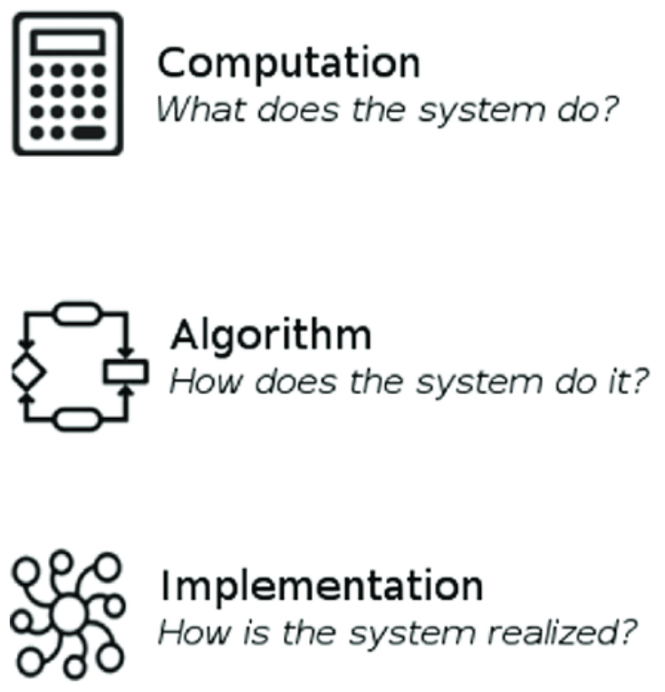
Reinforcement Learning as an Algorithm
Recap & Overview
RL = linking actions to delayed outcomes
Today:
Today: algorithmic story across fields
Theme: from Hebb to error-driven learning
Notes:
Last time, we stayed at the computational level.
We defined the problem reinforcement learning is meant to solve:
linking actions now to outcomes that may be delayed in time.
We saw why Hebbian association is powerful, but also why it cannot by itself solve that problem.
Today we shift to the algorithmic level.
Here the question is: what internal rules and representations could actually solve this problem in practice?
Instead of looking only at what needs to be done,
we’ll look at the different ways psychology, engineering, and AI tried to do it.
The theme is a story: we’ll start with Hebbian rules, move through early AI experiments,
and then see how error-driven learning emerged as the solution.
This path takes us from the simplest associative rules all the way to Sutton’s temporal difference learning,
which set the stage for modern reinforcement learning.

Slide 4
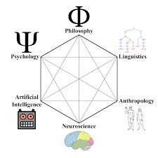
Reinforcement Learning as an Algorithm
A Multidisciplinary Story:
Psychology: conditioning & trial-and-error
Engineering: adaptive filters & delta rule
AI: early neural nets & RL models
Notes:
One thing that makes reinforcement learning so fascinating is that no single field “invented” it.
The ideas emerged independently in psychology, in engineering, and in artificial intelligence.
Psychologists were studying how animals learn from experience,
starting with Pavlov’s conditioning and Thorndike’s puzzle boxes.
They developed models like Rescorla–Wagner to explain why associations form or fail.
Engineers were working on adaptive filters and signal processing.
In the process, Widrow and Hoff came up with the delta rule
— a way to adjust connection weights based on the error between predicted and actual outputs.
Meanwhile, AI researchers were trying to build machines that could learn through trial and error.
Marvin Minsky’s early work with neural networks,
and later Sutton’s temporal difference learning, grew from this tradition.
These efforts started apart, often unaware of each other.
But over time, they converged on the same key idea:
learning depends not just on co-occurrence, but on prediction error — the difference between what is expected and what actually happens.

Slide 5
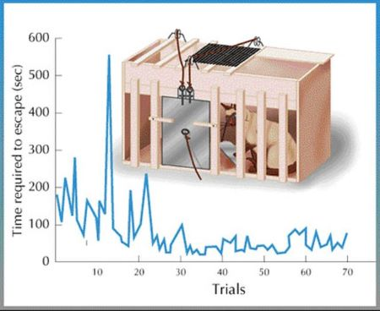
Reinforcement Learning as an Algorithm
Thorndike’s Trial-and-Error
Cats in puzzle boxes
Law of Effect: rewarded actions stamped in
Early psychology of reinforcement
Notes:
As we discussed in the previous lecture,
at the turn of the 20th century, psychologist Edward Thorndike studied how animals learn by trial and error.
He placed cats in puzzle boxes that could only be opened by performing some action,
like pulling a loop or pressing a lever.
At first, the cats tried many random movements.
Over repeated trials, the useless movements dropped out,
and the successful action was performed more quickly and reliably.
From this, Thorndike proposed the Law of Effect.
Actions that lead to satisfying outcomes become “stamped in.”
Actions that lead to annoying outcomes are weakened.
This was one of the first explicit statements of reinforcement learning in psychology.
It made clear that learning isn’t just about co-occurring events — it’s about the consequences of actions.
But Thorndike’s work left the algorithmic details vague.
How, exactly, do you adjust the strength of connections based on consequences?
That’s the problem later researchers would try to formalize.

Slide 6
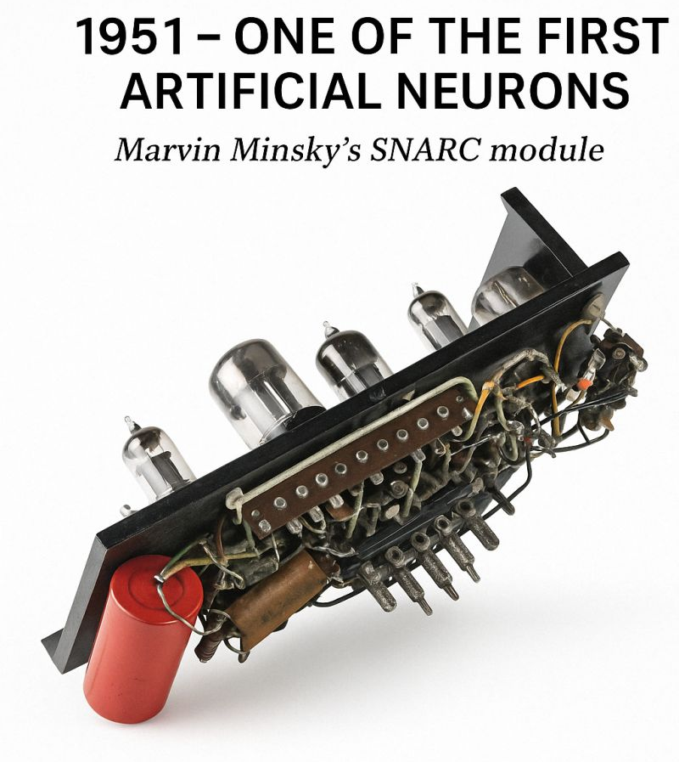
Reinforcement Learning as an Algorithm
Minsky’s SNARC (1951)
Neural network maze-solver
40 neurons, reinforced recent synapses
Worked in simple cases, failed in complex ones
Notes:
Last lecture, we described reinforcement learning at the computational level:
the problem is linking actions now to outcomes that may come later.
But at the algorithmic level, we want to ask: what actual rules could make a system do that?
One of the first attempts came from Marvin Minsky in 1951, with a machine he called the SNARC.
It was built from 40 electronic neurons connected randomly, and its task was to solve simple mazes.
The update rule was simple: when the machine reached the goal, it strengthened the synapses that had been active most recently.
The idea was to reward the path it had just taken.
This worked for very simple mazes — but it failed quickly as the tasks grew more complex.
The machine often reinforced the wrong connections, or missed the critical earlier steps that had led to success.
The SNARC made the transition from problem statement to algorithmic attempt.
It showed that trial-and-error learning could be mechanized,
but also highlighted the challenge:
how do you decide which actions deserve credit when the reward only comes at the end?

Slide 7

Reinforcement Learning as an Algorithm
The Temporal Credit Assignment Problem
Which action deserves credit?
Last action reinforced, earlier ones ignored
Reinforce all actions equally → too slow
Notes:
The SNARC’s failure illustrates a deep algorithmic challenge: the temporal credit assignment problem.
Imagine an animal, or a machine, performing a sequence of actions to reach a reward.
Which of those actions should get the credit?
If you only reinforce the very last action,
you risk missing the crucial earlier steps that made success possible.
If you reinforce all the actions equally, learning becomes impossibly slow,
because most of those steps don’t actually matter.
The system wastes effort strengthening irrelevant connections.
This is the formal version of the problem we introduced last lecture at the computational level.
Back then, we said reinforcement learning must connect actions now with delayed outcomes.
At the algorithmic level, the challenge becomes clear: what update rule can assign credit correctly across time?

Slide 8
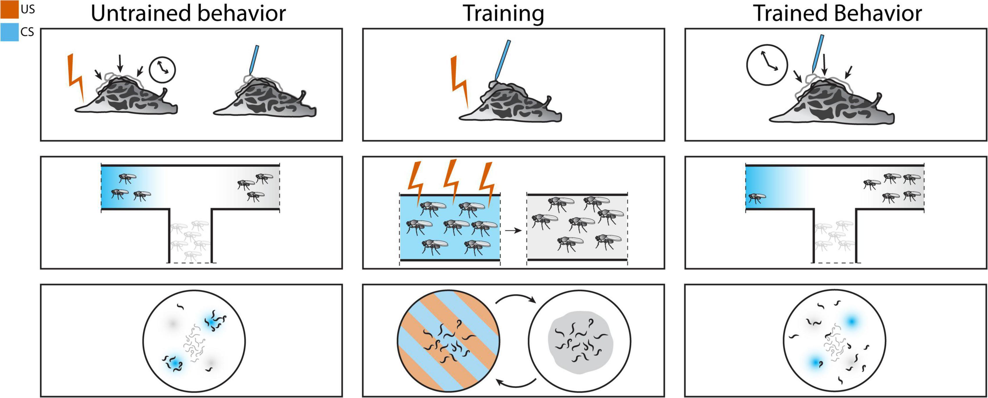
Reinforcement Learning as an Algorithm
How Hebb Can Support Reinforcement
Associations shift action probabilities
Cues paired with outcomes bias behavior
Reinforcement can shape Hebbian plasticity
Notes:
Before we move on, it’s important to note that Hebbian learning and reinforcement learning aren’t completely separate.
In some cases, Hebbian association can actually support reinforcement.
When a cue and an outcome occur together, Hebbian learning strengthens their connection.
That association can then bias behavior, making the animal more likely to act in ways that bring the outcome again.
Take a simple example.
Suppose a rat hears a tone, and at the same time food is delivered.
Hebbian learning strengthens the tone→food connection.
On later trials, the tone itself becomes a cue that makes the rat approach the food tray.
So here, Hebbian association changes the probability of a rewarded action.
Reinforcement can also shape which Hebbian associations stick.
If both a light and a tone are present, but only the tone predicts food,
the reinforcement signal will strengthen the tone→food link and weaken the light→food link.
That’s how psychologists explain blocking and overshadowing.
So in practice, Hebbian and reinforcement learning interact.
Hebb lays down the associative links, and reinforcement signals bias which ones matter.
But — as we’ll see next — this isn’t enough when outcomes are delayed.
For those cases, Hebb needs help from more powerful, error-driven rules.

Slide 9
Reinforcement Learning as an Algorithm
Why Hebb Fails at RL
Correlation-based, not outcome-based
No way to handle delayed consequences
Struggles with credit assignment
Notes:
Let’s go back to our rat with the tone and food example.
When the tone and food arrive together, Hebbian learning works fine.
The rat learns to approach the food tray when it hears the tone.
But imagine we change the timing.
Suppose the tone sounds, and only ten seconds later food arrives.
By then, the neurons for the tone and the neurons for the food are no longer active at the same time.
Hebbian learning can’t connect them, so the rat never learns that the tone predicts food.
Or think about a more complex sequence, like pressing a lever after hearing the tone,
then moving to the tray, and only then getting food.
Which of these steps should get reinforced?
If Hebb only reinforces the last step, it misses the crucial lever press.
If it reinforces everything, it ends up strengthening irrelevant behaviors
like grooming or sniffing that just happened to occur along the way.
And finally, notice that Hebb doesn’t care about valence.
It strengthens connections whether the outcome is good or bad,
as long as activity overlaps.
That means it can reinforce actions that actually reduce survival,
simply because they happened at the wrong time.
So Hebbian learning has serious failure modes.
It works for short, immediate pairings, but it breaks down when outcomes are delayed,
when sequences matter, or when valence needs to be tracked.
That’s why reinforcement learning requires outcome-sensitive, error-driven rules.

Slide 10
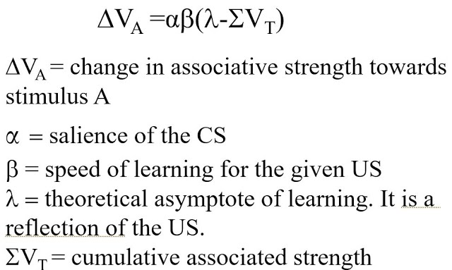
Reinforcement Learning as an Algorithm
Rescorla–Wagner model (1972)
Error-Driven Learning Emerges
Widrow–Hoff delta rule (1960)
Rescorla–Wagner model (1972)
Independent origins, same core idea
Notes:
In the 1960s and 70s, two different fields independently hit on the same key principle:
weight updates should be driven by error, not just correlation.
In engineering, Widrow and Hoff developed the delta rule for their ADALINE system.
The idea was to update weights based on the difference between the desired target output and the actual output.
In shorthand: Δw ∝ (target – output) × input.
This made learning outcome-sensitive — the weights only changed when the system was wrong.
Meanwhile, in psychology, Rescorla and Wagner were puzzling over results in classical conditioning, like blocking.
They proposed that the strength of a conditioned stimulus changes in proportion to the prediction error:
the difference between what was expected and what actually occurred.
Even though these models came from completely different traditions, they converged on the same core insight.
Learning happens when there is a mismatch between expectation and reality.
Error-driven rules provide a much more powerful foundation for reinforcement learning than Hebb’s simple correlation.

Slide 11
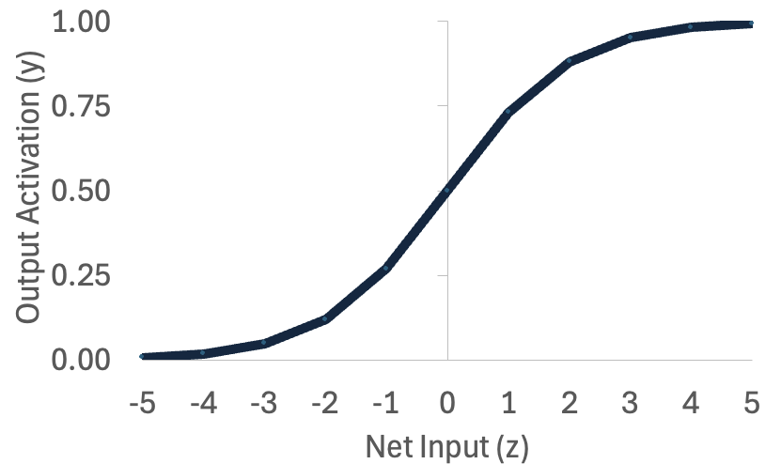
Reinforcement Learning as an Algorithm
x₀=1
b₀
z
y
b₁
Worked Example: Learning AND
Task: (1,1) → 1, all others → 0
Hebb: strengthens co-occurrence
Delta: adjusts by error correction
x₁
b0 | b0 | b1 | b2
Starting Weights | 2 | 5 | -2
Target Weights | -15 | 10 | 10
b₂
x₂
x0 | x1 | x2 | y
1 | 1 | 1 | 1
1 | 1 | 0 | 0
1 | 0 | 1 | 0
1 | 0 | 0 | 0
Notes:
Let’s work through a simple example to see how Hebbian and delta learning rules differ in practice.
The task is to learn the logical AND function.
The rule is that the output should be 1 only when both inputs are 1.
For all other input combinations, the output should be 0.
Now imagine we start with a small network that has two inputs and one output.
With Hebbian learning, the update rule is Δw = η × x × y.
That means weights strengthen whenever the input and output are active at the same time.
On the trial where the input is (1,1) and the output should be 1, both inputs and the output are active, so their connections strengthen.
On all the other input cases, the output is 0, so no change occurs.
Hebb therefore captures the correlation between both inputs being on and the output being on.
With the delta rule, the update is Δw = η × (target – output) × input.
Here, the weight change depends on the error between the target and the prediction.
If the system predicts 0 but the target is 1, the weights increase.
If the system predicts 1 but the target is 0, the weights decrease.
This gives the system a clear signal about which direction to adjust on every trial.
The takeaway is not that one works and the other fails, at least in this simple task.
It’s that Hebb adjusts weights whenever things co-occur, while delta adjusts weights only when there is an error.
Both can learn the AND function, but they operate on fundamentally different principles.

Slide 12
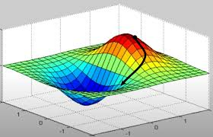
Reinforcement Learning as an Algorithm
From Delta Rule to RL
Error signals stronger than correlation
Psychology + engineering converge
Foundation for modern RL
Notes:
What the delta rule and the Rescorla–Wagner model showed is
that error-driven updates are far more powerful than simple co-occurrence.
Instead of strengthening connections just because things happened together,
the system asks: was I right or wrong about what would happen?
That error signal gives clear guidance about how to change.
What’s striking is that this insight emerged in two totally different domains.
Engineers wanted adaptive filters that could adjust to noisy signals.
Psychologists wanted a model that explained why some conditioned associations form and others don’t.
Both ended up with essentially the same mathematics.
These convergent discoveries laid the groundwork for modern reinforcement learning.
They showed that the key to solving credit assignment is to update weights based on prediction error, not correlation.
That principle is what Sutton and others later extended into a full algorithm for reinforcement learning across time.

Slide 13
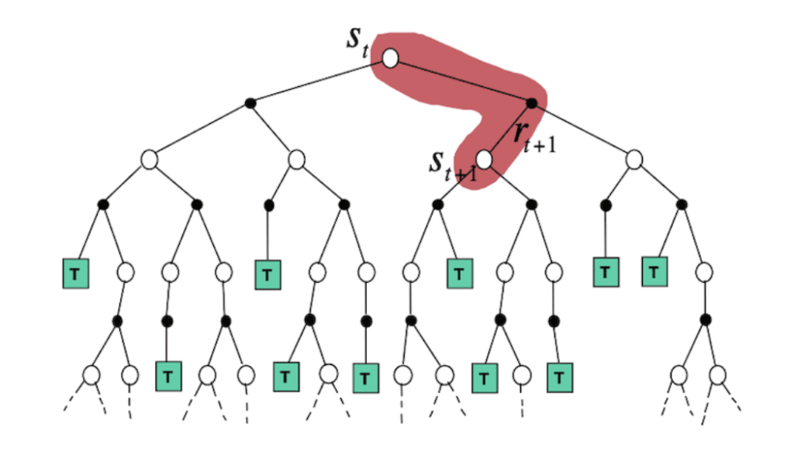
Reinforcement Learning as an Algorithm
Sutton’s Breakthrough: Temporal Difference Learning
Update predictions after each action
Error = new prediction – old prediction
Helps choose better actions
Notes:
In the 1980s, Richard Sutton extended the delta rule to create what we now call temporal difference learning, or TD learning.
The key insight was this: you don’t need to wait until the very end of a sequence to get an error signal.
You can update your expectations continuously by comparing one prediction to the next.
If your new prediction is better or worse than the old one, that difference itself is an error signal.
This gives you a moment-to-moment teaching signal that works even when the final outcome is delayed.
Instead of reinforcing all actions equally, or only the very last one,
TD learning spreads credit backward through the sequence of states.
This solved the temporal credit assignment problem in a way that was practical and efficient.
It provided a clear algorithm: use prediction errors at each step to gradually propagate value information backward,
linking present actions with future consequences.

Slide 14
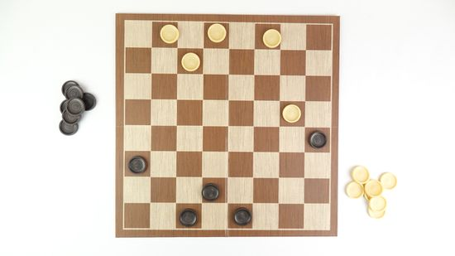
Reinforcement Learning as an Algorithm
Sutton’s Breakthrough: Temporal Difference Learning
Update odds of winning after each move
Error = new prediction – old prediction
Helps choose better actions
Notes:
Let’s make this concrete with checkers.
Suppose you’re at a particular board position.
Your system tries to estimate the chance of winning from here — say, 40%.
But in order to act, you need to compare the outcomes of different possible moves.
Let’s say you can move a piece forward or you can jump an opponent’s piece.
If you move forward, the new board position has a predicted win chance of 35%.
If you jump, the new position is predicted at 60%.
Temporal difference learning lets the system update immediately based on this shift.
The difference between the new prediction and the old one is the error signal.
Here, the jump produces a +20% improvement relative to the original 40%, while the forward move produces a –5% drop.
That error signal tells the system not just which states are good,
but which moves improve your chances of winning.
Over many games, the system strengthens the actions that lead to better-than-expected positions,
and weakens those that make things worse.
This is what solves the credit assignment problem.
Instead of waiting until the very end of the game,
the system learns step by step which actions improve its long-term odds of success.
So temporal difference learning allows us to update after each move by comparing new and old predictions.
But we’ve been talking about two different roles here, even if we haven’t labeled them yet.
One role is estimating how good the board position looks.
The other is choosing which move to make based on those evaluations.
To make things clearer, researchers separated these into two interacting parts: the critic and the actor.

Slide 15
Reinforcement Learning as an Algorithm
Actor
Critic
Two Roles in Temporal Difference Learning
Evaluating positions (predictions)
Choosing moves (actions)
Both are needed in checkers
Notes:
So far we’ve been describing temporal difference learning in checkers.
Notice that we’ve actually been talking about two different roles, even if we haven’t named them yet.
One role is evaluating how good a board position looks — estimating the probability of winning from that state.
The other role is choosing which move to make, based on those evaluations.
To make things clearer, researchers separated these into two interacting parts.
The first does the evaluating.
The second does the acting.
Together, they work as a system that can learn both predictions and actions more effectively.

Slide 16
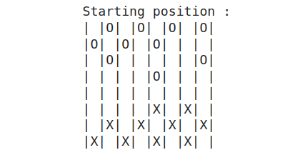
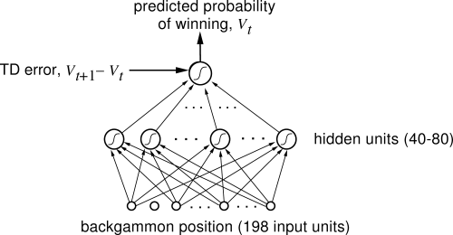
Reinforcement Learning as an Algorithm
Actor–Critic Model
Critic: evaluates states (predicted value)
Actor: chooses actions based on evaluations
TD error links them together
Notes:
With this framing, the critic is the part that evaluates board positions.
It learns to predict the chance of winning from each state, and whenever the prediction changes, it produces a temporal difference error.
The actor is the part that chooses moves.
It uses the critic’s evaluations as guidance.
If the critic says the new position is better than expected, the actor strengthens the move that led there.
If it’s worse, the actor weakens that move.
So in checkers, if a jump raises the predicted chance of winning from 40% to 60%, the actor learns to favor jumps in that situation.
If moving forward lowers the prediction to 20%, the actor learns to avoid it.
By dividing the system into these two roles, we get a clean, scalable way to learn.
The critic improves its evaluations, the actor improves its choices, and the temporal difference error keeps them aligned.

Slide 17
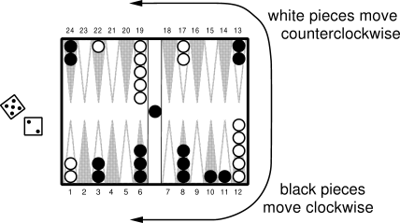
Reinforcement Learning as an Algorithm
TD Learning in Practice: TD-Gammon
Tesauro’s backgammon AI (1990s)
Trained by self-play with TD updates
Reached near-expert human level
Notes:
The power of temporal difference learning really came into view in the early 1990s with a program called TD-Gammon, built by Gerald Tesauro at IBM.
TD-Gammon was a backgammon-playing AI that started with no built-in strategy.
It learned entirely by playing games against itself, adjusting its weights using temporal difference updates after every move.
Each time its prediction of eventual winning improved or worsened, that error signal adjusted its evaluation function and its choice of actions.
The results were stunning.
In just a few months of training, TD-Gammon reached near-expert human level.
It not only outperformed all earlier hand-coded programs but also discovered new strategies that human players later adopted.
This was a watershed moment.
It showed that the abstract principles of prediction error and temporal difference updating weren’t just theoretical.
They could scale up to real, complex domains and produce human-level competence

Slide 18

Reinforcement Learning as an Algorithm
RL Today: Ubiquitous Applications
Game-playing AIs (Chess, Go, StarCraft)
Robotics & control systems
Everyday tech: ads, recommendations, resource allocation
Notes:
Since TD-Gammon, reinforcement learning has become one of the most widely used AI tools.
In the research world, it’s famous for mastering games.
DeepMind’s AlphaGo and AlphaZero used RL to learn Go, chess, and other games at superhuman levels.
Other systems have gone on to handle complex strategy games like StarCraft and Dota.
In robotics and control, RL is used to train robots to walk, grasp, and fly.
Instead of being programmed step by step, the robot explores, tries actions, and learns which ones succeed.
But perhaps the most important examples are in everyday life.
Every time you open YouTube, TikTok, or Instagram, an RL algorithm is working behind the scenes.
The system is constantly choosing which ad or video to show you,
based on a reward signal: how likely you are to click, keep watching, or engage.
It experiments with different content and updates its strategy based on what gets attention.
That’s why your feed feels personalized — it’s being shaped in real time by reinforcement learning.
The same is true for online advertising.
Companies bid for ad slots, and RL algorithms decide which ad to show to which user to maximize click-throughs and revenue.
Over billions of interactions, these algorithms fine-tune themselves to optimize engagement.
So when we study RL, we’re not only studying how animals and brains learn.
We’re also studying the exact same principles that drive your news feed, your ad recommendations, and much of the digital economy today.
For us, it also serves as a bridge.
If temporal difference learning works this well in machines, we should ask: does the brain implement something like it?
That question sets up our next lecture.

Slide 19
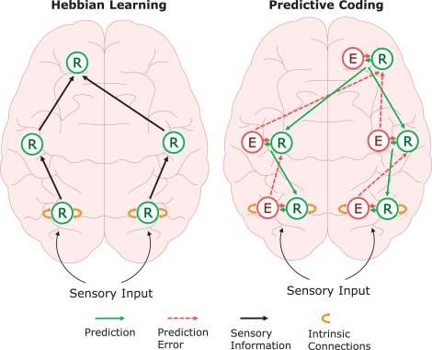
Reinforcement Learning as an Algorithm
Algorithmic Takeaways
Hebb: correlation-based associations
Error-driven: prediction error updates
Convergence across psychology, engineering, AI
Notes:
Let’s step back and summarize what we’ve seen.
Hebbian learning is simple and powerful.
It strengthens associations whenever inputs and outputs co-occur,
which explains a lot about reflexes and classical conditioning.
But it struggles when outcomes are delayed or when valence matters.
Error-driven learning solves that by using prediction error.
Weights change only when there’s a mismatch between what was expected and what actually happened.
This makes learning outcome-sensitive and allows credit to be assigned across time.
What’s remarkable is that these ideas emerged independently in different fields.
Psychologists discovered prediction error through experiments on conditioning.
Engineers invented the delta rule to solve problems in adaptive filters.
AI researchers rediscovered the same principles in Sutton’s temporal difference learning and in the actor–critic framework.
All of these strands converged on the same insight:
Reinforcement learning requires error-driven updates, not just correlations.
That’s the algorithmic solution to the problem we introduced at the computational level last time.

Slide 20
Reinforcement Learning as an Algorithm
What We Learned / What’s Next
RL needs prediction error, not just Hebb
Delta rule → TD learning → actor–critic
Next: how the brain implements these signals
Notes:
Today we traced the story of reinforcement learning at the algorithmic level.
We began with Hebbian learning — a simple, correlation-based rule that can capture associations but struggles with delayed outcomes.
We saw how early psychology, engineering, and AI each wrestled with the credit assignment problem.
From Thorndike’s puzzle boxes to Minsky’s SNARC, the challenge was clear: how do you assign credit for success across time?
The breakthrough came with error-driven learning.
The delta rule and the Rescorla–Wagner model independently introduced prediction error as the driver of learning.
Richard Sutton extended this with temporal difference learning, making it possible to propagate value information back through sequences.
The actor–critic framework added structure, separating evaluation from action.
And systems like TD-Gammon proved that these ideas scale up in practice.
So the key lesson is this: reinforcement learning depends on prediction error updates, not just correlation.
That’s what allows organisms and machines to learn effective strategies over time.
Next time, we’ll move from algorithms to implementation.
We’ll ask: where in the brain are these prediction error signals found?
And we’ll see how circuits in the basal ganglia and the dopamine system bring reinforcement learning to life in real neural tissue.

